Slide 1
Toxic Comment Classification
Sai Chintha
Dishant Shah
Ruta Bhat

Slide 2
Dataset
comment_text
toxic
severe_toxic
obscene
threat
insult
identity_hate
. . .
0
0
0
0
0
0
. . .
1
0
0
0
1
0
.
.
.
.
.
.
.
.
.
.
.
.
.
.
.
.
.
.
.
.
.
. . .
1
0
1
0
0
1

Slide 3
Dataset
10%
had any positive class label
160,000 comments

Slide 4
Approach 1 - Random Neural Network
comments needed to be represented as number based input
Built vocab dictionary that contains 20,000 highest frequency words
Replaced every word in each comment with index of that word as it appears in dictionary
output
input
hidden
toxic
Used sigmoid activation for output layer as will give us an output value between 0-1 for each class label
severe_toxic
obscene
.
.
.
threat
insult
100
X 64
identity_hate

Slide 5
Approach 1 - Random Neural Network
output
input
hidden
toxic
Training Data Set : 80%
severe_toxic
Cross Validation Data Set : 20%
obscene
Accuracy : 89% on training set
.
.
.
threat
Accuracy : 36% on cross validation set
insult
100
X 64
identity_hate

Slide 6
Approach 1 - Random Neural Network
Improvements needed:
needed a better representation of input
explored word vectors: GloVe from Stanford (trained on Wikipedia articles)

Slide 7
Approach 2 - Neural Network with pre-trained word vectors
input
Used pre-trained word vectors: GloVe from Stanford (trained on Wikipedia articles)
with the same model as Approach 1
For example:
“How are You”
20
40
13
Approach 1
“How are You”
Approach 2
1x100
1x100
1x100
word embeddings contain semantic information between words and help represent the data better than just the indexes
100

Slide 8
Approach 2 - Neural Network with pre-trained word vectors
input
Training Data Set : 80%
Cross Validation Data Set : 20%
Accuracy : 95% on training set
Accuracy : 91% on cross validation set
100

Slide 9
Approach 2 - Neural Network with pre-trained word vectors
Improvements Needed:
Example Comments
needs contextual information
“I’m gonna kill you!”
explored recurrent neural networks(RNN’s)
“The program killed my computer”
research papers show that RNN’s can pick up on contextual information just like convolutional neural networks do for image data

Slide 10
Approach 3 - RNN with pre-trained word vectors
Chose LSTM (Long Short Term Memory) and added it to the Neural Network of approach 1.
Used a max pooling layer to get the maximum weighted activation.
Used 100 dimensional vectors. Max length of input is 100.

Slide 11
Approach 3 - RNN with pre-trained word vectors
Training Data Set : 90%
Cross Validation Data Set : 10%
Accuracy : 98.14% on training set
Accuracy : 97.23% on cross validation set

Slide 12
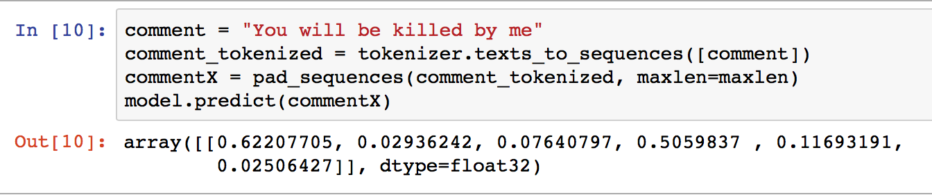
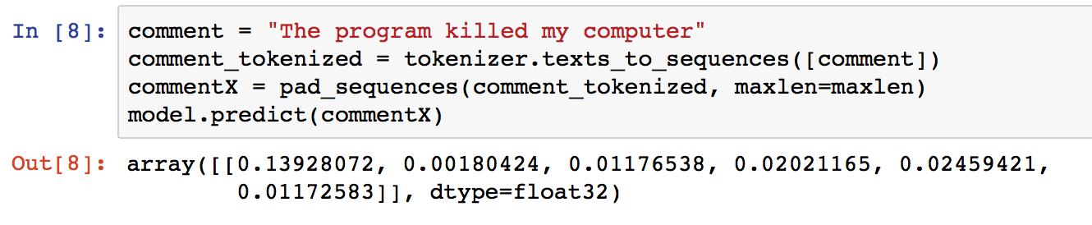
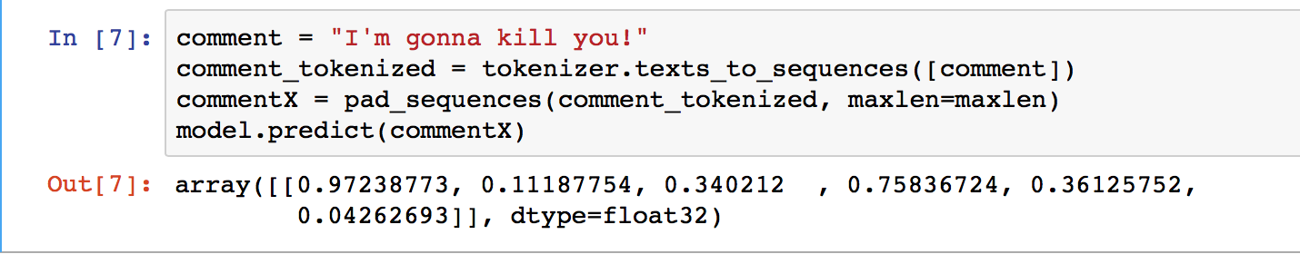
Approach 3 - RNN with pre-trained word vectors
Example Predictions
toxic
severe_toxic
obscene
threat
insult
identity_hate

Slide 13
Approach 4.1 - RNN with pre-trained word vectors
Approach 4.2 - RNN with pre-trained word vectors
Training Data Set : 90%
Training Data Set : 90%
Cross Validation Data Set : 10%
Cross Validation Data Set : 10%
Used 200 dimensional vector and maximum comment length of 150
Used 300 dimensional vector and maximum comment length of 150
Accuracy : 98.25% on training set
Accuracy : 98.33% on training set
Accuracy : 97.86% on cross validation set
Accuracy : 98.65% on cross validation set

Slide 14
Split Ratio
Training Accuracy
Cross Validation Accuracy
Approach 1 Random Neural Network
80:20
89.14%
36.08%
Approach 2 Neural Network with pre-trained word vectors
80:20
95.01%
91.24%
Approach 3 RNN with pre-trained word vectors
90:10
98.14%
97.23%
Approach 4.1 RNN with pre-trained word vectors
90:10
98.25%
97.86%
Approach 4.2 RNN with pre-trained word vectors
90:10
98.33%
98.65%

Slide 15
Future Directions
Extend the word embedding by concatenating GloVe and FastText (FAIR)
Handle different language, possibly translate said language to English using Google Translate
Translate to a completely different language like Dutch and then back from Dutch to English for all comments. Should help with regularization
Add lots of densely connected layers and train for large number of epochs (deep learning)

Slide 16
Any Questions?

